Slide 1
Presenter Disclosure
Faculty: J Jewitt-Harris, A Jewitt-Harris, A Ready
Relationships with commercial interests:
Grants/Research Support: None outside of charitable fundraising
Speakers Bureau/Honoraria: None
Consulting Fees: None
Other: None
Notes:
This slide must be visually presented to the audience AND verbalized by the speaker.

Slide 2
Disclosure of Commercial Support
This program has received financial support from a variety of charitable trusts and foundations in the form of charitable donations
This program has received no in-kind support
Potential for conflict(s) of interest:
None
Notes:
This slide must be visually presented to the audience AND verbalized by the speaker.

Slide 3
Extending Renal Transplantation to LMIC – Convincing Politicians may be the Biggest Challenge Jennie Jewitt-Harris, Aimee Jewitt-Harris and Andrew Ready
Dr Jennie Jewitt-Harris
Chief Executive
Transplant Links
www.transplantlinks.org
You are welcome to share details of this presentation responsibly and with due credit on social media. This is a presentation at #ESOT2019 regarding the work of @TransplantLinks

Slide 4
Development of Renal Transplantation in LMICs
The increased incidence of kidney failure in LMIC’s in Africa, Asia, Caribbean is well known
The need for RRT is self-evident
Renal transplantation may be the most cost-effective
Local teams technically capable & facilities available
Teaching skills of live donor transplantation offers a way forward
Transplant Links (TLC) has been supporting the development of sustainable kidney transplant programs in LMICs for over 12 years (1)
1. Ready A et al, Establishing sustainable kidney transplantation programs in developing world countries: a 10-year experience, Kidney International 2016 Nov;90(5):916-920

Slide 5
Transplant Links (TLC)
TLC is a UK registered NGO that organises volunteer clinicians to partner with centres in LMICs to achieve
De novo program development
Development of fledgling kidney transplant programs
Guidance to centres considering a program
TLC has supported centres in Ghana, Nigeria, Kenya, Uganda, Zambia, Nepal, Jamaica, Barbados, Bermuda, and Trinidad

Slide 6
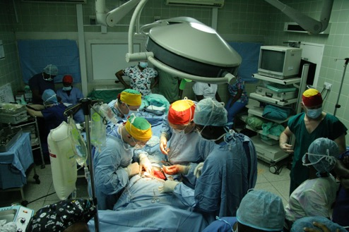
Skill transfer
On-site mentoring
Performance of living donor procedures
Facilitation of UK training fellowships and short observer training visits
Online learning/materials (podcasts, training modules, lectures etc)
A reliance on volunteer renal transplant clinicians and healthcare professionals for long-term partnerships
The approach has been successful with regards to skill transfer, with good clinical outcomes (published/in progress)

Slide 7
Challenges
Educational
Health Literacy (2)
Cultural
Ethical
Infrastructure
Communications
Financial
Political
2. Jewitt-Harris, J & Ready, A Health Literacy in the Development of Kidney Transplantation Programs in Low and Middle-Income Countries in: Vassilios, E & Theodosopoulou, M (2018) Optimizing Health Literacy for Improved Clinical Practices. IGI Global

Slide 8
Challenges
Educational
Health Literacy (2)
Cultural
Ethical
Infrastructure
Communications
Financial
Political
2. Jewitt-Harris, J & Ready, A Health Literacy in the Development of Kidney Transplantation Programs in Low and Middle-Income Countries in: Vassilios, E & Theodosopoulou, M (2018) Optimizing Health Literacy for Improved Clinical Practices. IGI Global

Slide 9
The Political Challenge
Political engagement can be challenging
Necessity for political understanding of the problems of kidney failure & benefits (clinical and financial) of transplantation
Local financial commitment necessary for service development
Lack of political support for long term planning and resourcing
Achieving sustainability is critically dependent on political support
Need for lobbying of politicians by the international renal/transplant community and societies
Empowering renal patients to seek improved care

Slide 10
Thank you
Thank you to:
All TLC volunteers, medical faculty and supporters
Aimee Jewitt-Harris, Andrew Ready, Dwomoa Adu, Peter Unsworth, David Milford, David Youds, Beverley Evans, Nick Inston, Graham Lipkin, Paul Cockwell, Lukas Foggensteiner, Raj Thuraisingham, Shazia Shabir, Nerissa Jurawan, Stephen Mellor, Marc Clancy, Ben Lindsey, Paulette Williams-Jones, Isobel Wells, Colette Somerville, Gordon Evans, Rachel Wilkins, Vicki Farrant, Amanda Justice, Laura Ludman, Malcolm Samuel, Jay Nath,
Patrons: Baroness Floella Benjamin, Lord Bernard Ribeiro, Quentin Cooper
Professor Sir Magdi Yacoub, Elsie Owusu, Baroness Julia Cumberlege
www.transplantlinks.org

