Slide 1
A Guide To Living Donor Kidney Transplantation
Gordon Evans
Operating Department Practitioner

Slide 2
The Aims Of This Presentation
To give theatre staff a brief overview of Donor Kidney Transplantation
To provide some insight into how it is surgically performed
To describe what preparation needs to be done prior to any transplantation.
Detail how to Create your own Surgical Trays
List Consumbales that need ordering and purchasing
Describe how we set up theatre
Provide Hints and Tips to make the operations go smoothly.

Slide 3
The Left kidney is most commonly donated and the patient is positioned Right Lateral, with Jack Knife (kidney break)

Slide 4
The Donor Nephrectomy is performed hand assisted laparoscopically through two 10/12mm ports and an incision for the surgeons hand.

Slide 5
The Picking Area is set up in close proximity to the surgeons. With a clear path that allows a quick transfer from the patient to the picking trolley.

Slide 6
The Day Before Donor
Kidney Transplantation
In the days leading up to Donor Kidney Transplantation the fluids for cold perfusion and static storage of the Kidney need to be prepared.
For cold perfusion the following is needed:
2L Cold refrigerated Soltran solution (Baxters) - Alternatively 2L Ringer’s
For Static Storage of the Kidney the following is needed:
2L Frozen Ringer’s
2L Slushy Ringer’s ( can be substituted for 1L frozen Ringer’s)
2L Cold refrigerated Ringer’s
*Non sterile ice is also required to maintain the temperature of the static storage.
**It is essential that this step is performed prior to the operating day to avoid cancellation of surgery.

Slide 7
Key Moments in
The Donor Nephrectomy
Preparation of surgical instruments
Anaesthetised patient is positioned in the lateral position with Kidney Break
Surgical Prep and draping
Knife to skin
Mobilisation of kidney using ligasure energy device.
Mobilisation of renal vessels and ureter
Preparing of picking table, cold perfusion and static storage.
Stapling/ clipping of ureter
Vascular stapling of renal vessels
Cold perfusion of donor kidney
Recording of key times e.g Clamps on and Cold perfusion
Further picking of donor kidney
Closure of skin
Operation complete

Slide 8
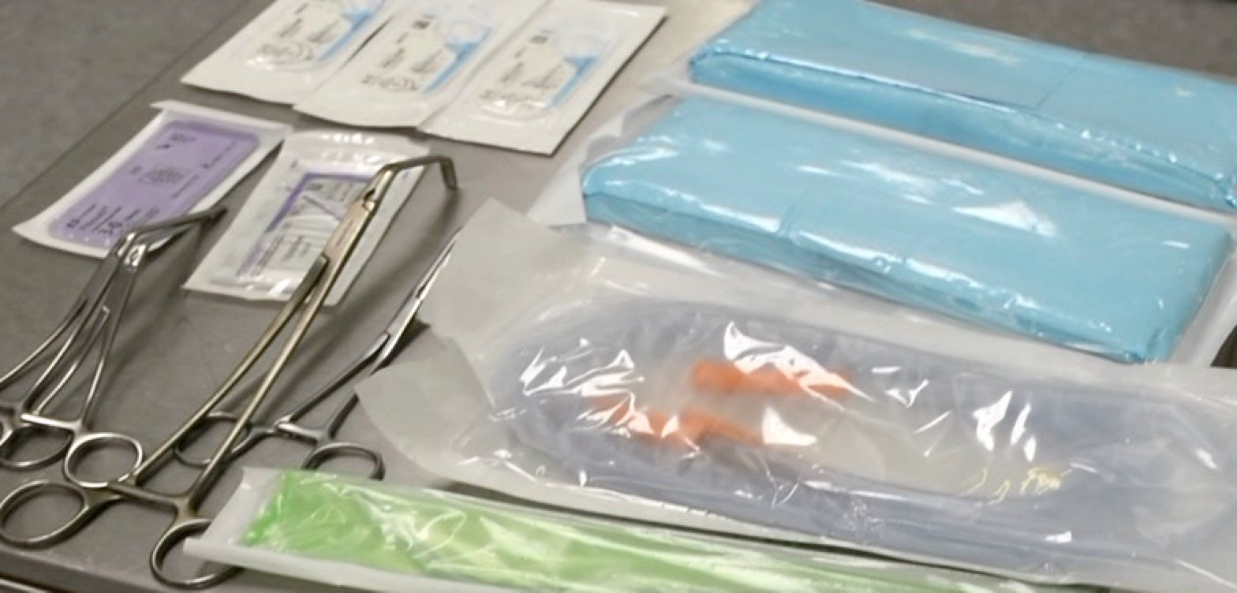
What Happens If We
Need To Convert?
Assist surgeon with conversion to open.
Ask circulation staff to open Transplant Extras Tray for the vascular clamps, Medium Swabs, Prolene vascular sutures ranging from 3-0/5-0, vicryl ties 0/3-0, suction and yakaeur.

Slide 9
The Picking Table is a back bench that allows the surgical team to cold perfuse the kidney and place it in a static storage. Occasionally alterations are made to the vessels for transplantation.

Slide 10
The picking area consists of a stainless steel trolley, surgical instruments/consumables, drip stand, bowl stand, suction unit and if available a light source.

Slide 11
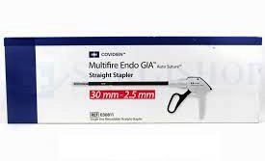
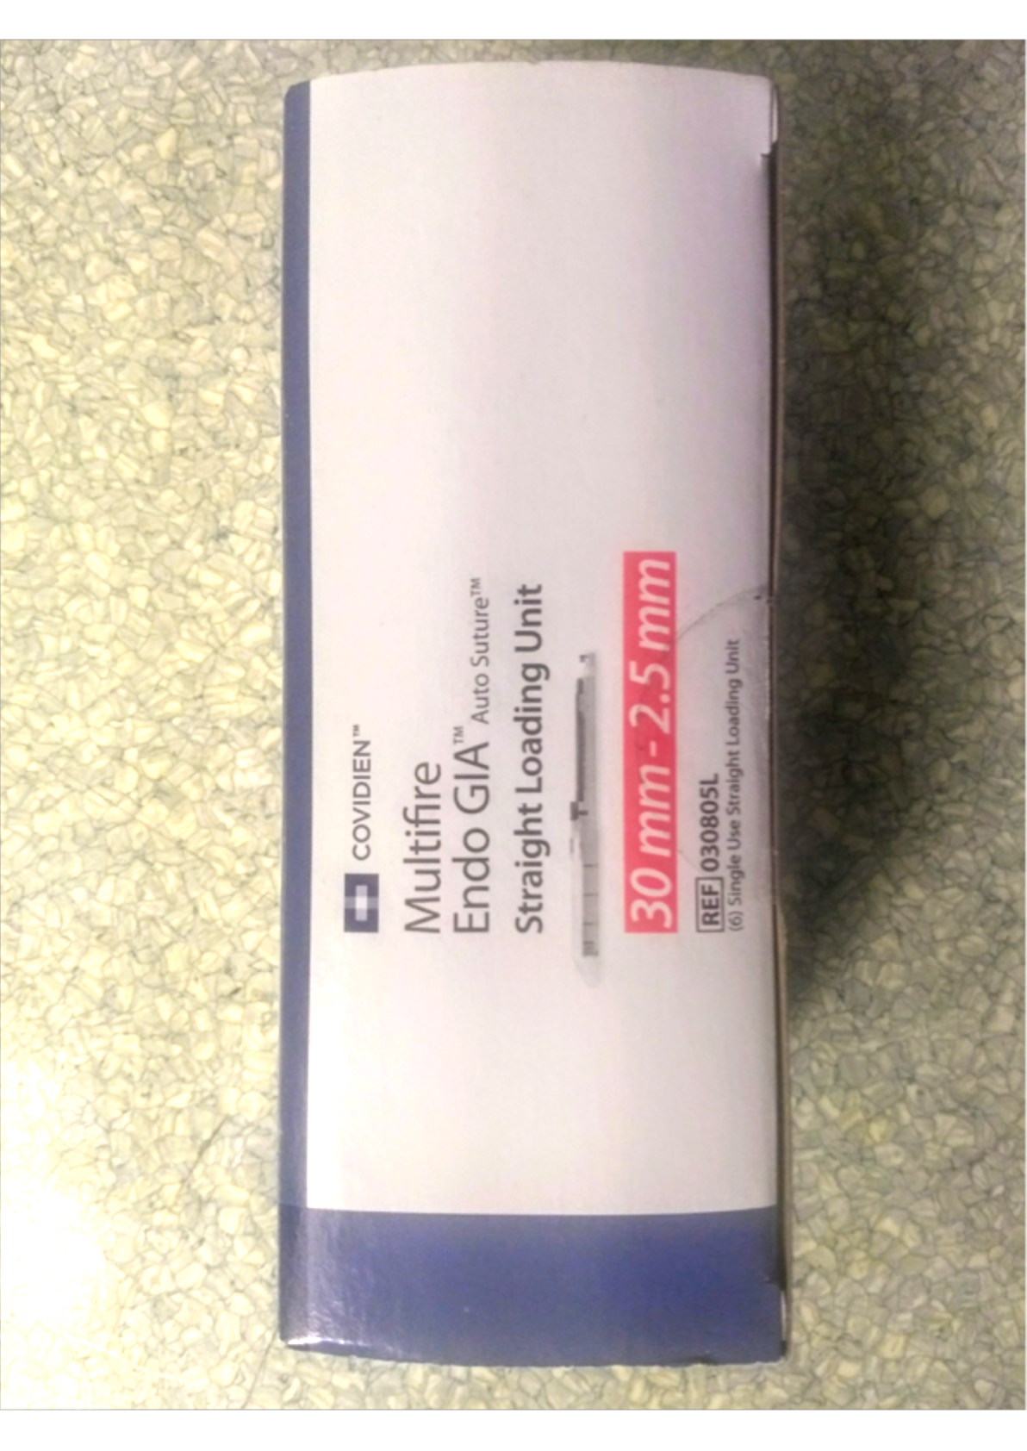
Donor Nephrectomy:
Essential Purchases
Ligasure: Laparoscopic Sealer/Divider:
either the Dolphin tip or Maryland can be successfully used for the donor nephrectomy. Made by medtronic/Covidien,
Marland ref: LF1937
Dolphin ref: LS1500
Vascular Stapler by Medronic/Covidien,
Ref: 030811
This product comes preloaded, so additional reloads will need to be purchased. There is an alternative product by Ethicon
Vascular Reloads by Medronic/Covidien,
Ref: 030805L
For each Donor nephrectomy you will require a reload for each vessel and the ureter if desired. Addition reloads in case of misfires are highly recommended on the side.

Slide 12
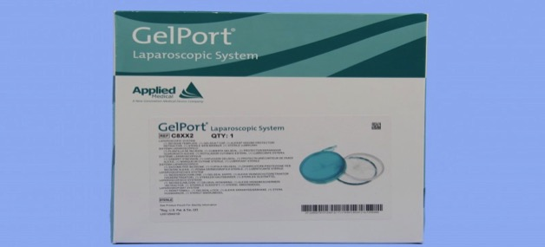
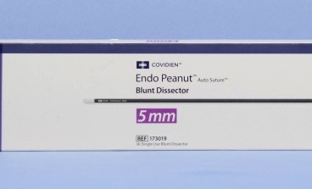
Donor Nephrectomy:
Desirable Items
Hand Port, Applied Medical
Product Ref: C8XX2
Extremely useful product for creating a seal around the surgeons hand. Additional benefit of increasing operating space in slim donors.
Endo Peanut (Covidien/Medtronic):
Product reference: 173019
Used for blunt dissection, most commonly around the renal vessels. Not used for every case, but very useful.

Slide 13
It is most important to start creating your own instrument trays in order to be able to perform donor kidney transplantation. These are the instruments you will need….

Slide 14
The Picking Tray:
BP Handle NO.4
Mcindoe’s Forcep
Debakey Forcep
Mcindoe Scissors
Potts Scissors
Mosquitoe forceps x 10
Watson Cheyne Probe
Mayo needle holder x 2
Tibbs Cannula
Toffee Mallet

Slide 15
The Major Tray Checklist:
1x Bp Handle No4
1x BP Handle No3
1x BP Handle No3L
2x Ramsey Heavy Toothed Forcep
2x Gillies Toothed Forcep
2x Debakey Forcep 15cm
2x Debakey forcep 20cm
3x Sponge Holding Forcep
1x Nelson Scissors Curved 23cm
1x Mcindoe Scissor Curved
1x Mayo scissors
1x Dressing scissors blunt
1 x Dressing scissor sharp
2x Mayo needle holders 23cm
2x Mayo needle holders 19cm
2x Mayo needle holders16.5cm
2x Spencer wells Artery Forcep
10x Babcock towel clips
2x Allis forceps
2x Duval forceps
2x Littlewood forceps
2x Lahey Forceps
6x Dunhill Artery Forceps Crved 18cm
10x Dunhill Artery forceps curved 12.5cm
5x Mosquitos Forcep Curved 12.5cm
2x Czerny Retractors
2x Langenbeck Retrtactor
1x Morris Retractor Large
1x Morris Retractor Medium
1x Morris retractor Small
1x Finger switch diathermy blade

Slide 16
The Major Tray

Slide 17
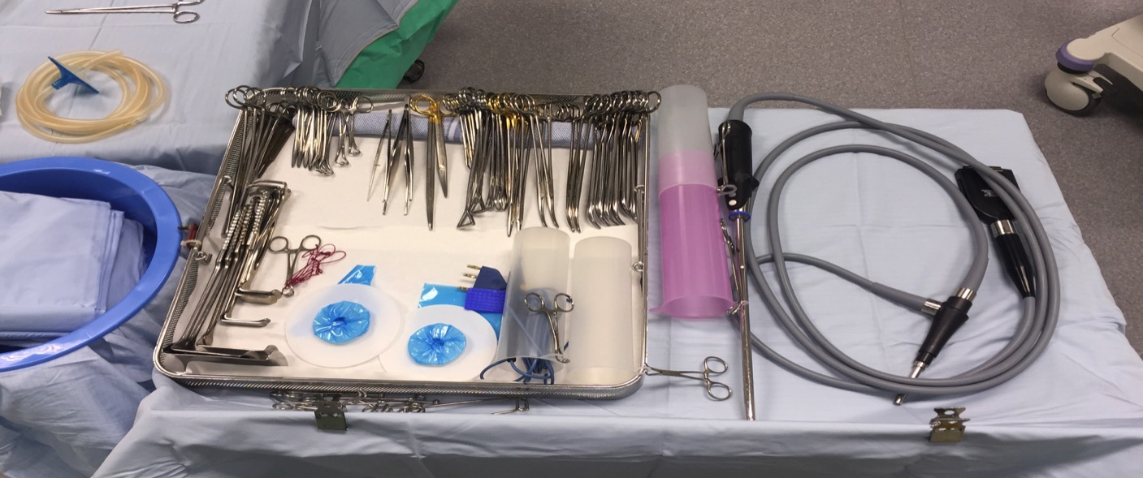
30 Degree Scope And
Light lead/Endoeye
This is a 30 degree Endoeye, alternative 30 degree scope and light leads are also suitable.

Slide 18
The Kidney Transplant Tray
1x BP Handle No.7
2x 9” Debakey Forcep
1x Mcindoe Forcep
4x12” Fine needle Holders
1x Lahey Forcep
1x Mcindoe Scissor
1x Potts Scissor
5x Straight Mosquitoe
2x Statinski Clamp
2x Peripheral Debakey Clamp
1x Paediactric Reynolds clamp
2x Bulldog/Zeppling/Yassagils
1x Watson Cheyne Probe
1x Nerve Hook

Slide 19
The Kidney Transplant Tray

Slide 20
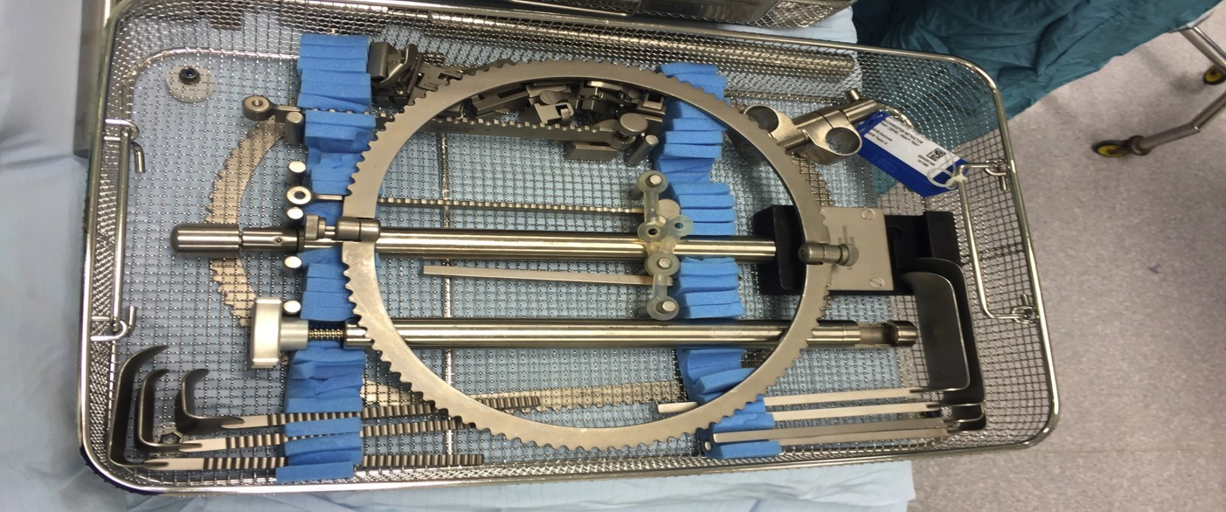
The Bookwalter Retractor
Alternative retractors can be used e.g Omnitract and Thompson’s

Slide 21
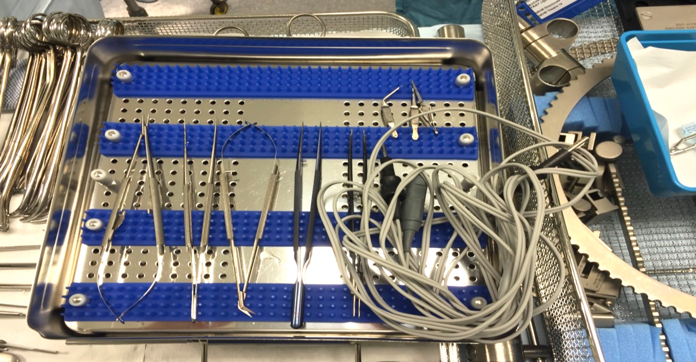
Micro Instruments
Essential instrumentation for vascular reconstruction.

Slide 22
Key Moments In
The Kidney Transplant
Anaesthetised Patient is catheterised and an infusion of 500 ml is attached to the end of the catheter.
Patient is prepped and draped
Knife to skin
Mobilisation of external iliac vessels
Renal vein anastomosed end to side with external lilac vein.
Renal artery anastomosed end to side with external iliac artery
Clamps removed and blood supply returned to kidney
Time of clamps off is recorded
Revision of anastomosis if required.
Fluffy swabs are used to absorb any leaking from anastomosis.
Ureteric implantation to bladder
Closure of Skin

Slide 23
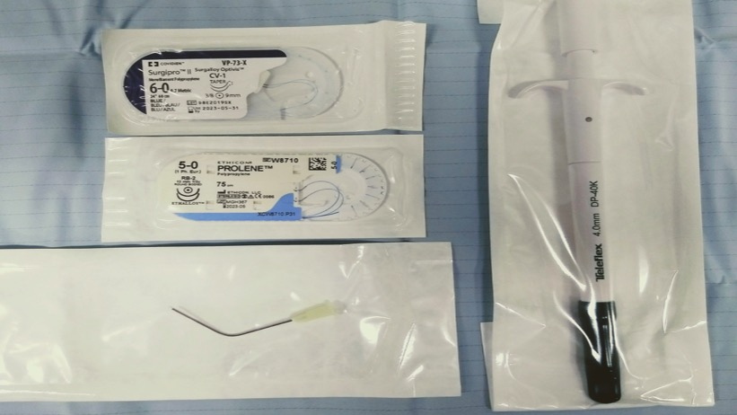
Kidney Transplant
Key Consumables
Aortic Punches ranging in sizes from 4-6mm
5-0 Prolene vascular suture ref: w8711
6-0 Prolene vascular suter ref: 8711
4-0 PDS suture ref: w9109
Angled cannula for heparinised saline

Slide 24
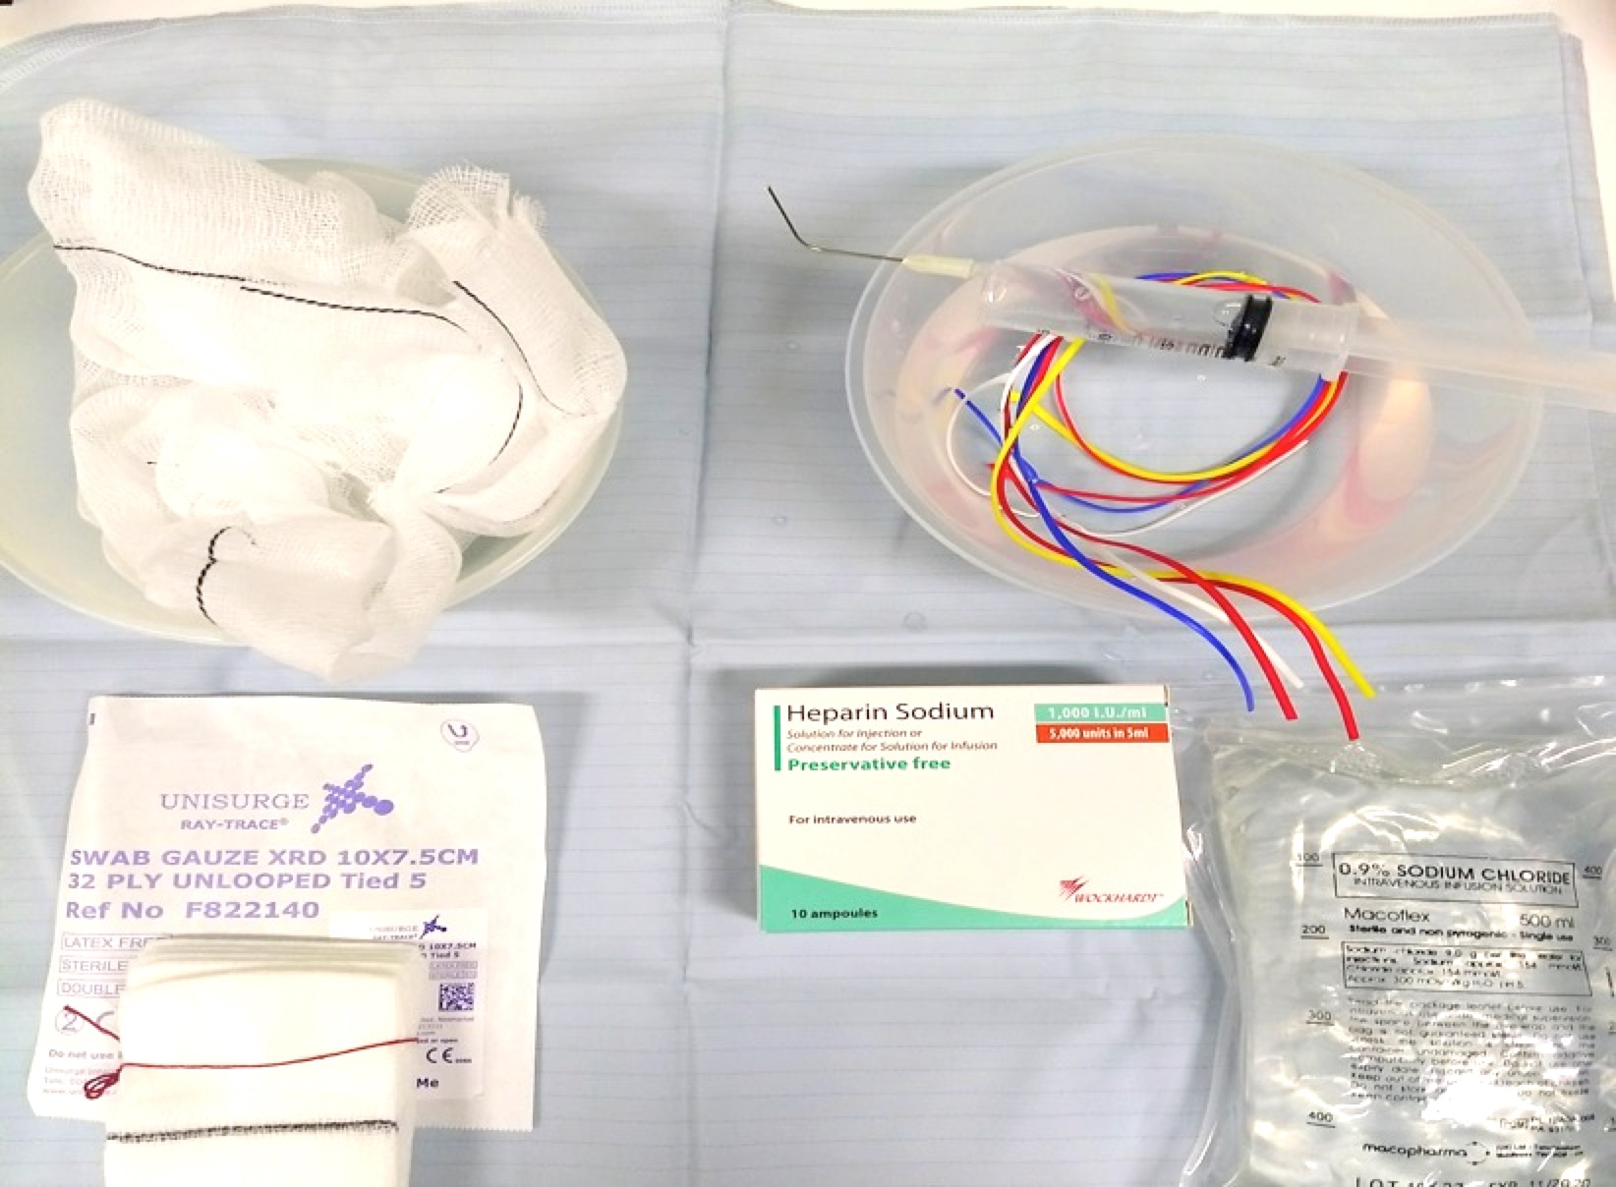
Other Key Preparations
For Kidney Transplants
5 Small raytec swabs opened up to create fluffy swabs
5000 i.u Heparin mixed into 500ml Saline.
20 ml syringe with angled cannula
Sloops for vessels

Slide 25
Contact Details
For any addition information please view our poster presentations alternatively contact me via email: gordon.evans@uhb.nhs.uk

